Slide 1
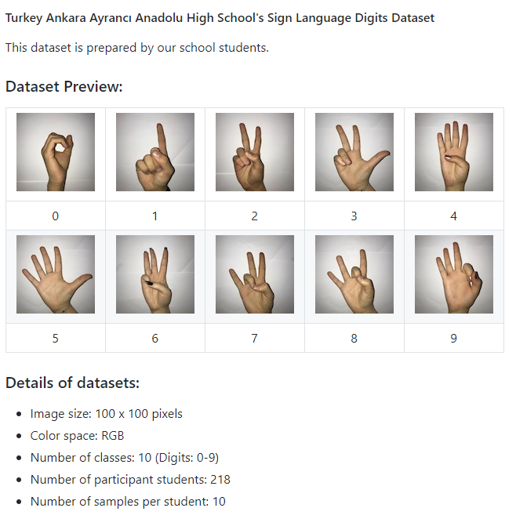
Deep Learning
Introduction to image recognition
Your work: load data, write a code with understading (follow all explanations), make recommended changes and send a code and visualizations to TEAMS.
Sign Language Digits
The distinction accuracy of
https://www.analyticsvidhya.com/blog/2021/05/a-comprehensive-tutorial-on-deep-learning-part-1/?utm_source=feedburner&utm_medium=email&utm_campaign=Feed%3A+AnalyticsVidhya+%28Analytics+Vidhya%29
Overview of the Data
There are 2062 sign language Digit Images in this dataset.
Since there are 10 digits from 0-9, there are 10 unique sign images.
We will only use 0 and 1 (To keep it simple for learners)
In the data, the hand sign for 0 is between indices 204 and 408. There are 205 samples for 0.
Also, the hand sign for 1 is between indices 822 and 1027. There are 206 samples.
Thus we shall use 205 - 206 samples from each class (Note: in reality 205 samples are very much less for a proper Deep Learning model, but since this is a tutorial, we can ignore that)

Slide 2
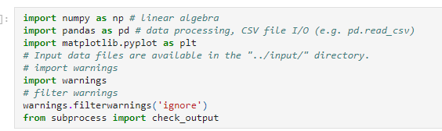
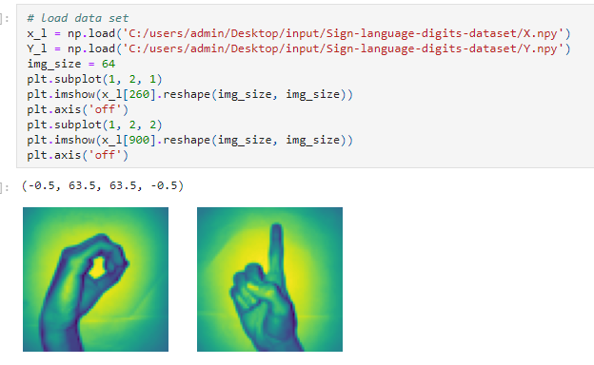


Importing Necessary Libraries
Now we will prepare our arrays X and Y, where X is our Image array(Features) and Y is our label array (0 and 1).
Find in Teams „files” input folder and download it to Your desktop
In the data, the hand sign for 0 is between indices 204 and 408. There are 205 samples for 0.
Also, the hand sign for 1 is between indices 822 and 1027. There are 206 samples.

Slide 3
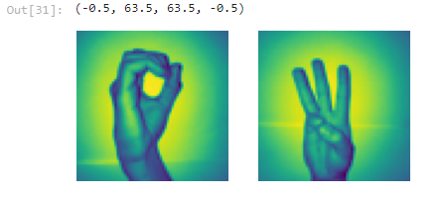
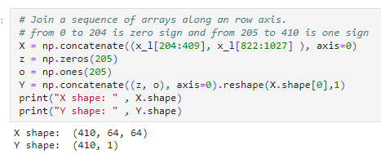
You can find another couples of digit signs changing a numbers of images in the code in previous page.
To create our X array, we first slice and concatenate our segments of 0’s and 1’s hand sign images from the dataset to the array X.
Next we do something similar with Y, but use the labels instead.
So we see that the shape of our X array is (410, 64, 64)
The 410 means 205 images of 0, 205 images of 1.
the 64 means that the size of our images is 64 x 64 pixels.
2) The shape of Y is (410,1) thus 410 1’s and 0’s.

Slide 4
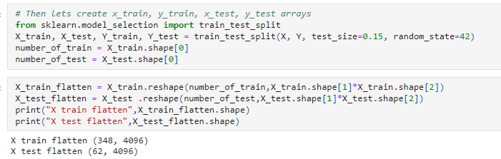
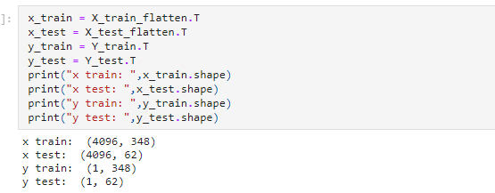
3) Now we split X and Y into train and test sets.
train = 85%, test = 15%
random_state = 42. Uses a particular seed while randomizing, thus if the cell runs multiple times, the random number generated does not change every time. The same test and train distribution are created every time.
Flattening image
We have a 3 Dimensional input array, so we have to flatten it to 2D to feed into our first Deep Learning model. Since y is already 2D, we leave it just as it is.
Now we have a total of 348 images, each with 4096 pixels in the training array X. And 62 images of the same pixel density 4096 in the test array.
Now we transpose (T) the arrays. This is just a personal choice and you will see in the upcoming codes why I did this.

Slide 5
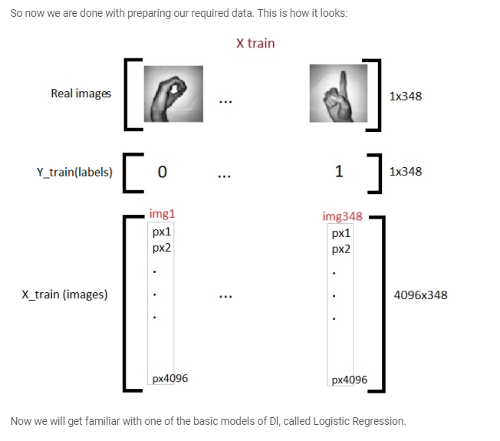
So now we are done with preparing our required data. This is how it looks:

Slide 6
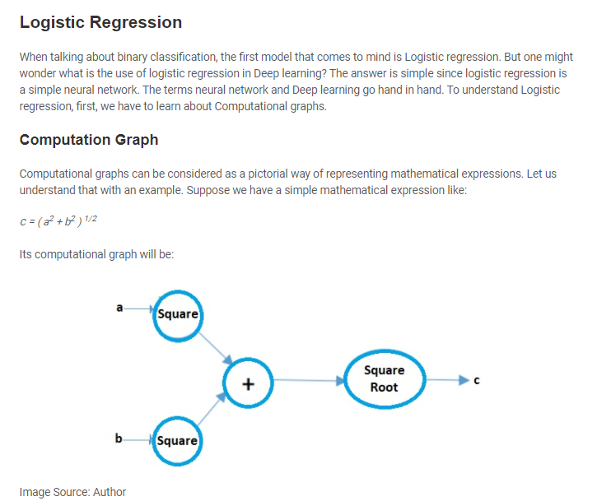

Slide 7
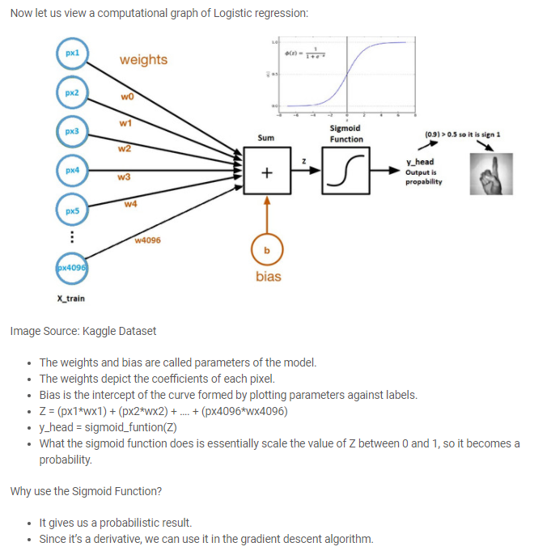
(Activation function)

Slide 8
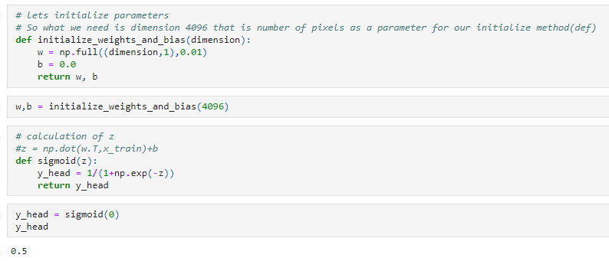
Each pixel has its own weight. But the question is what will be their initial weights? There are several techniques to do that, we can initialize them using any random value, let’s say 0.01.
The shape of the weights array will be (4096, 1), since there are in total 4096 pixels per image, and let the initial bias be 0.
Forward Propagation
All the steps from pixels to cost function is called forward propagation.
To calculate Z we use the formula: Z = (w.T)x + b. where x is the pixel array, w weights, and b is bias.
After calculating Z we feed it into the sigmoid function which returns y_head (probability). After that, we calculate the loss (error) function.
The cost function is the summation of all the losses and penalizes the model for the wrong predictions. This is how our model learns the parameters.

Slide 9
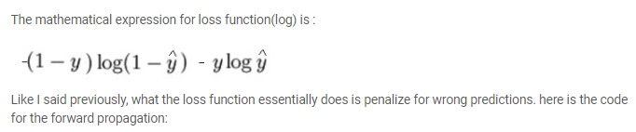
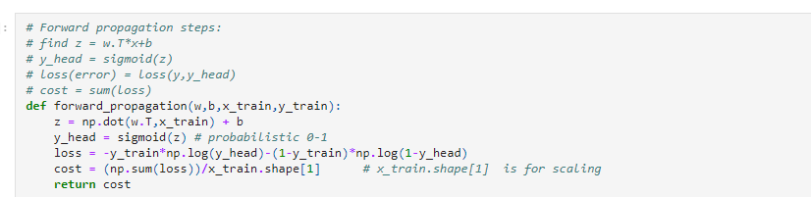
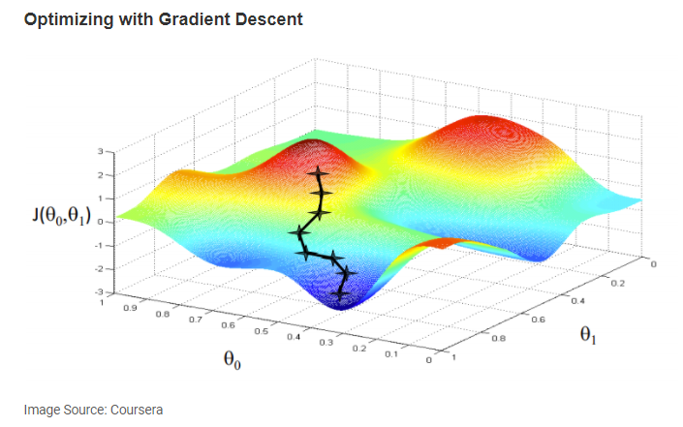

Slide 10

We aim to find the values for our parameters for which, the loss function is the minimum. The equation for gradient descent is:
Where w is the weight of the parameter. Greek letter alpha (α) is something called stepsize. What it signifies is the size of the iterations we’ll take while going down the slope to find local minima.
And rest is the derivative of the loss function, also known as the gradient. The algorithm for gradient descent is simple:
First, we take a random datapoint in our graph and find its slope.
Then we find the direction in which the value loss function decreases.
Update the weights using the above formula. (This method is also called backpropagation)
Select the next point by taking a stepsize of α.
Repeat.

Slide 11
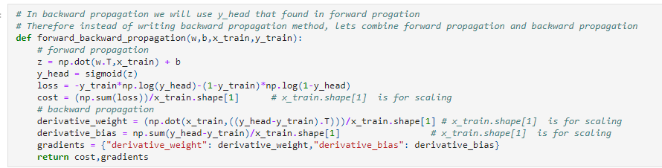
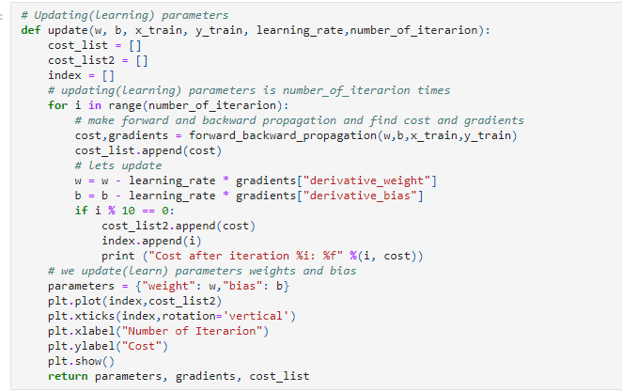
Now we update the learning parameters:

Slide 12
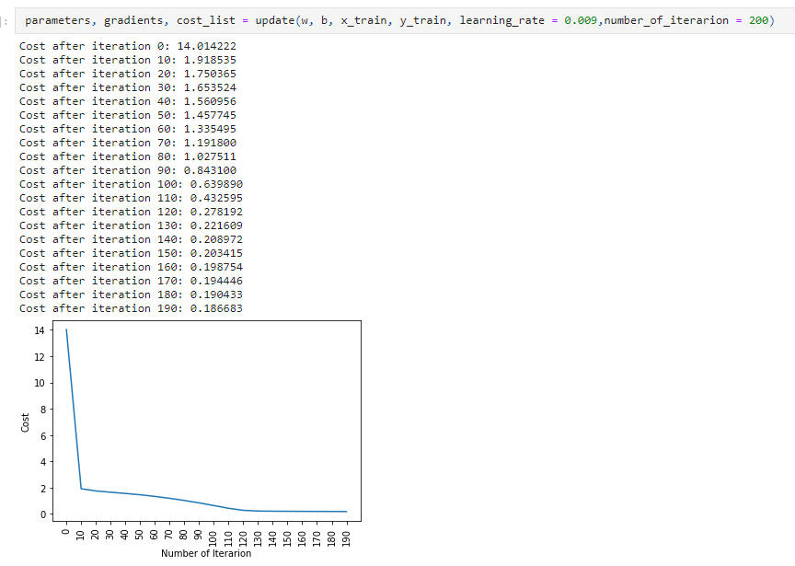

Slide 13
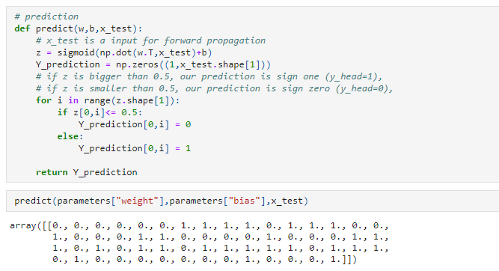

Slide 14
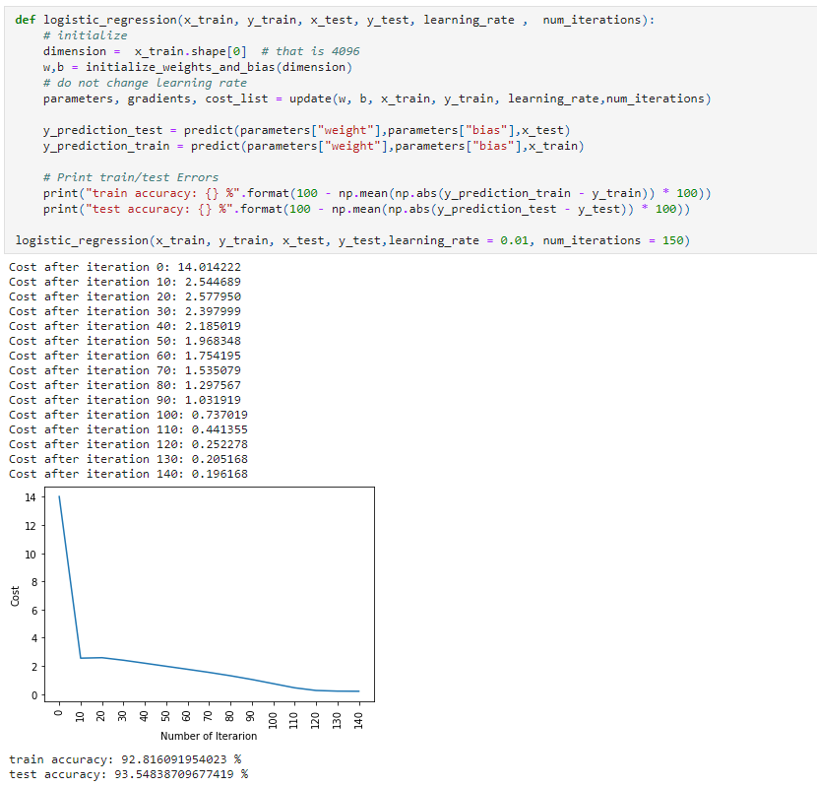
Now we make our predictions.
Let us put it all together:
Accuracy of the prediction

Slide 15
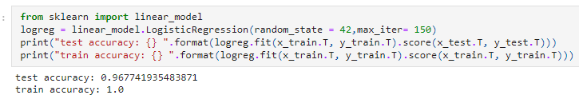
So as you can see, even the most fundamental model of Deep learning is quite tough. It is not easy for you to learn, and beginners sometimes might feel overwhelmed while studying all of this in the one go.
But the thing is we haven’t even touched deep learning yet, this is like the surface of it.
Since we have learned the logic behind Logistic regression, we can use a library called SKlearn which already has many of the models and algorithms built in it, so you don’t have to start everything from scratch.
Logistic regression using Sklearn
Here is the code, and I’m sure you will be flabbergasted to see how little effort it takes:
Accuracy of the Logistic Regression model

